Slide 1
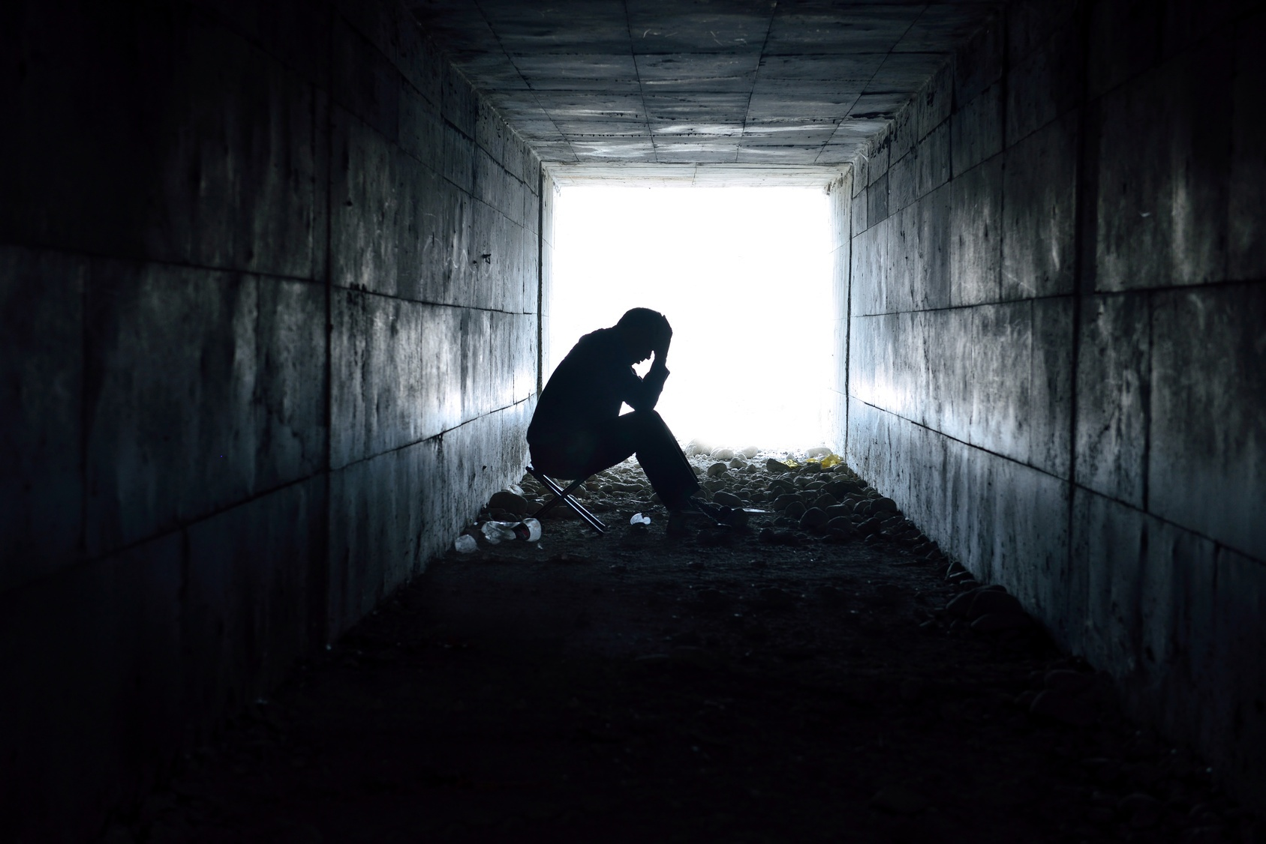
BBM421 GAME TECHNOLOGIES PROJECT
AGATEOPHOBIA
Ali Sahin Balikci
Gokay Atay
Sena Berre Ceylan

Slide 2
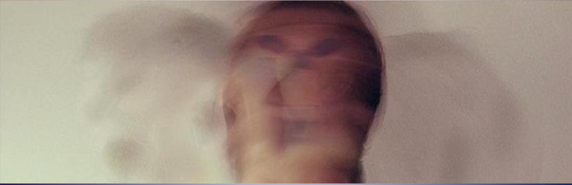
DESCRIPTION of the Game / RemInder
Agateophobia is a single player horror game. It can be defined under tags as horror, adventure, puzzle, mystery, choices/actions matters and story rich. It consists of three levels that individually designed and each level has different puzzle/puzzles. These puzzles will affect the ending of the game. Also player's choices and actions may change the game progress and gameplay.

Slide 3
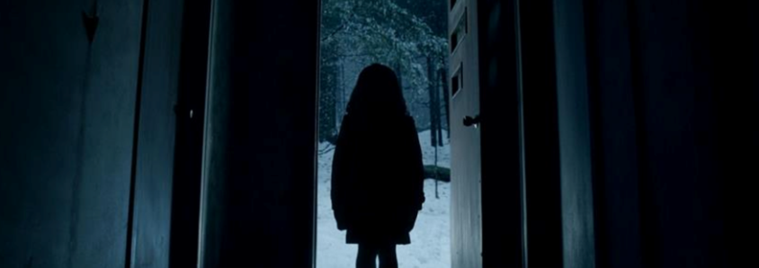
Agateophobia's main story consists of a paranoid man, his past, present thoughts and dreams. Like his daughter's death, bad things he's been through combined with his phobia makes him insane. He starts to see the reality different, depending on his subconscious. He blames himself about his daughter’s death (burnt in their house), and through the game he is hallucinating about his daughter, places that he’s been through and so on.

Slide 4
Agateophobia can be played in first person view, player experiences the action through the eyes of the protagonist and can control the character via keyboard/mouse. Environment changes in each level and player can interact with some objects in the scenes. There will be some cinematics occurred in the gameplay and there are some horror stuff like sound effects and jump-scares.

Slide 5
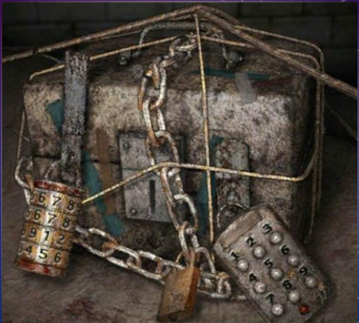
Player is forced to discover the environment in an undirected way. Puzzles must be solved for the game progress, also these puzzles and timing is important for the ending.

Slide 6
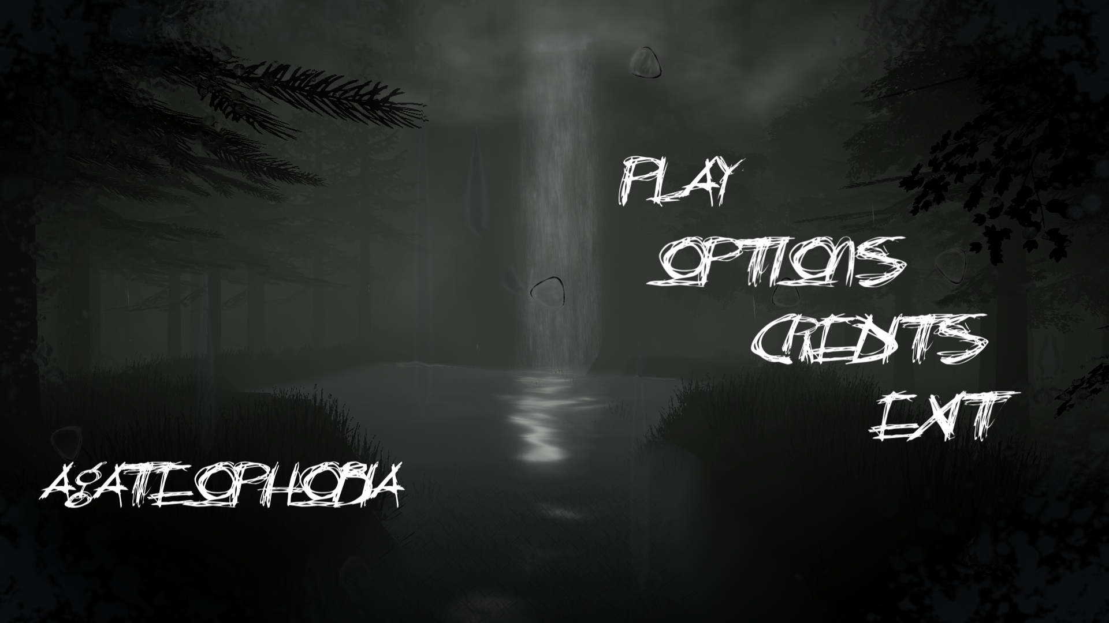
MAIN MENU

Slide 7
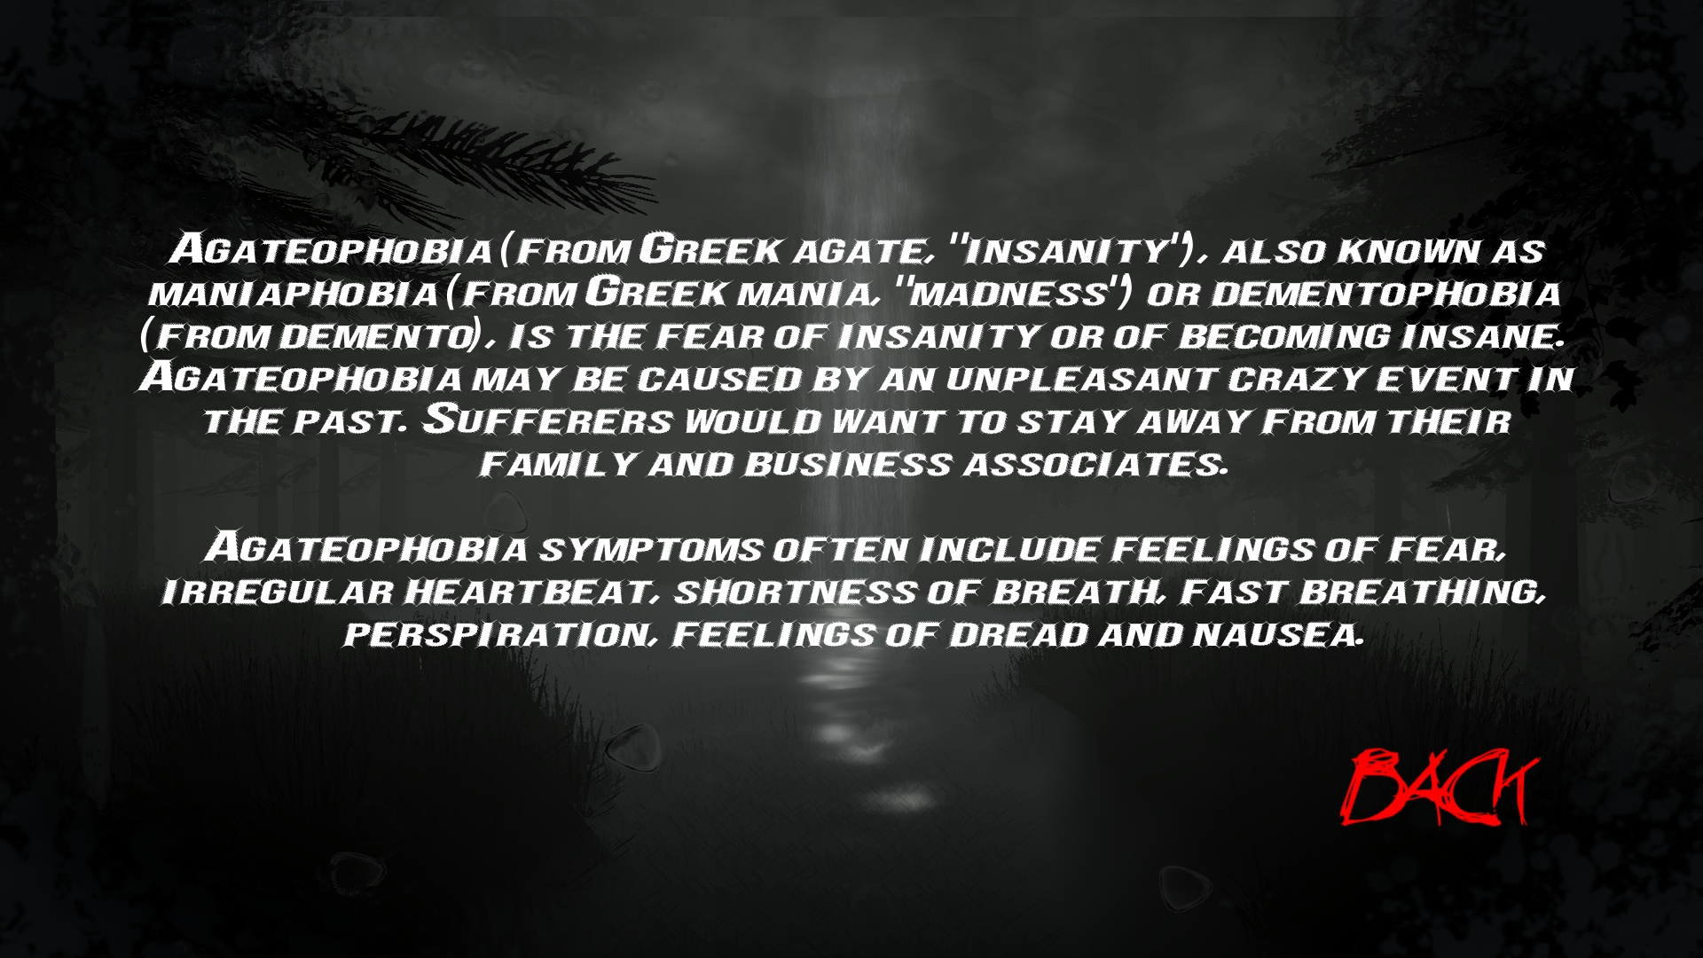
AGATEOPHOBIA (SUB-MENU)

Slide 8
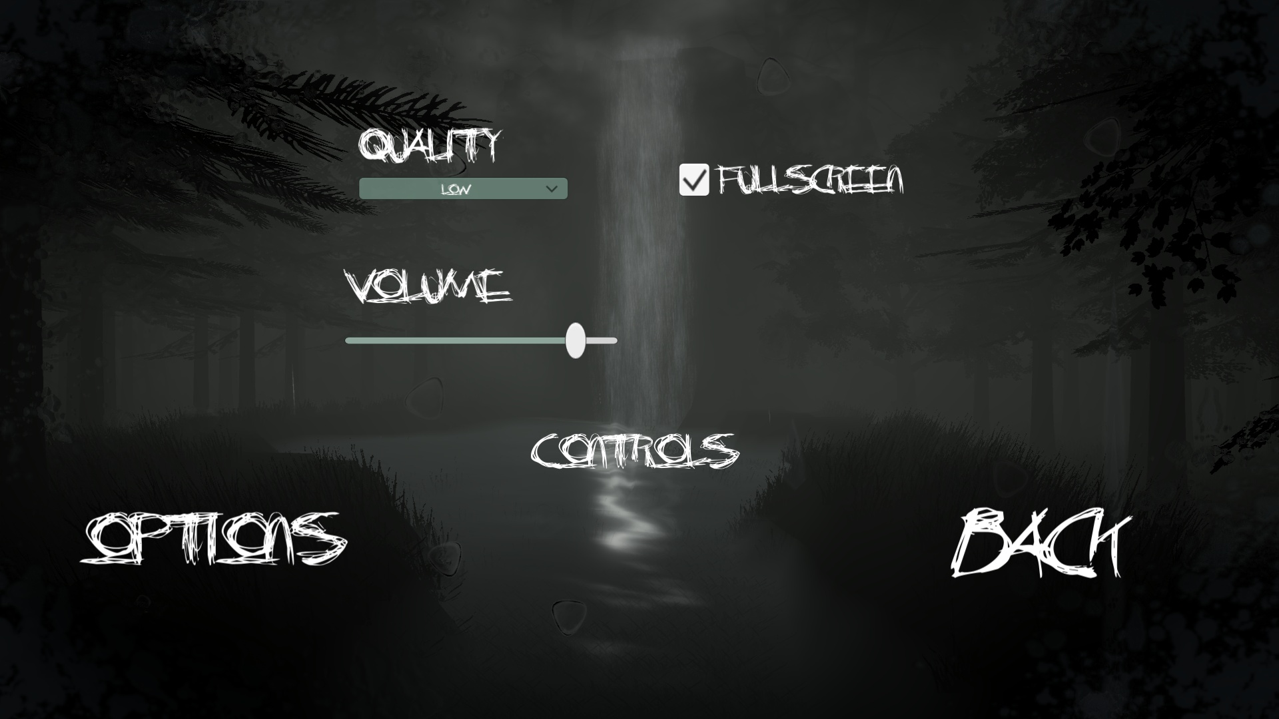
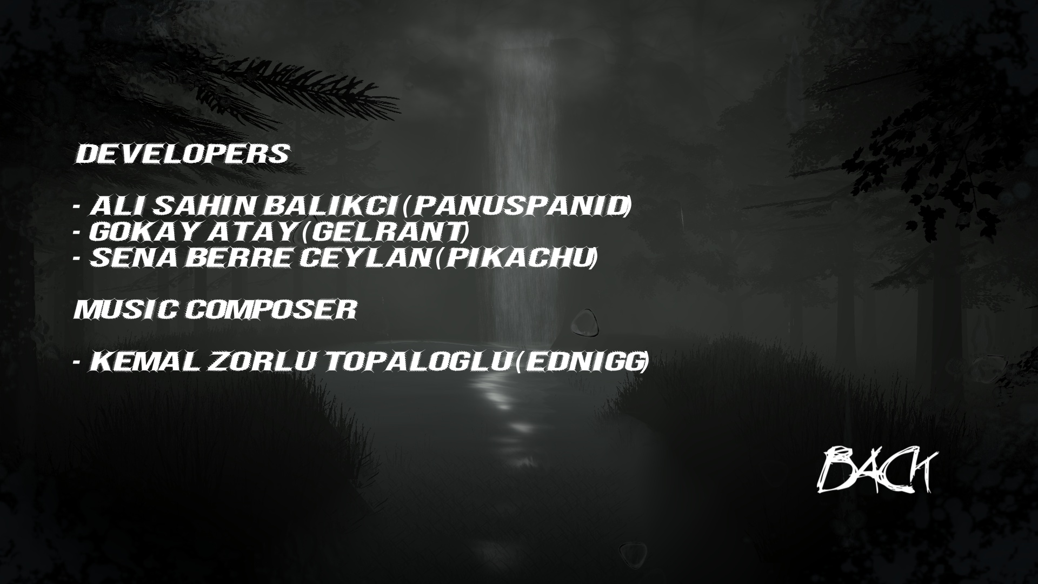
OPTIONS & CREDITS (SUB-MENU)
OPTIONS
CREDITS

Slide 9
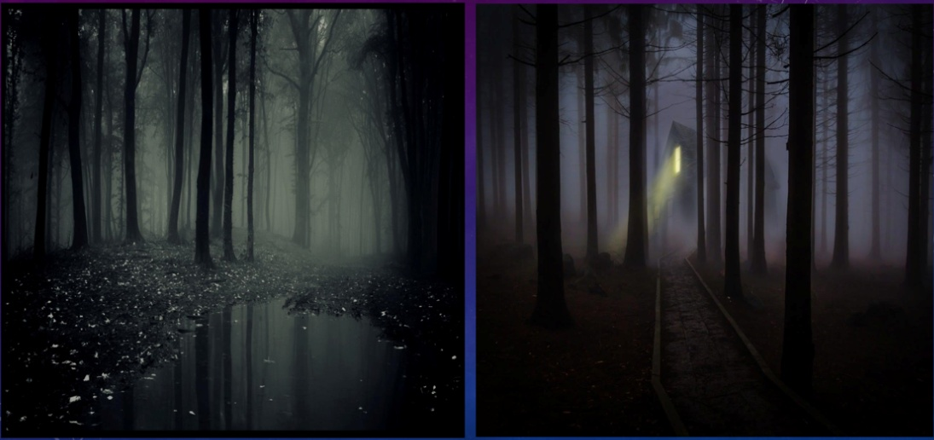
LEVEL 1 – HAUNTED FOREST (SUMMARY OF #P1)
We mentioned before, on the project proposal, how the haunted forest scene would look like.

Slide 10
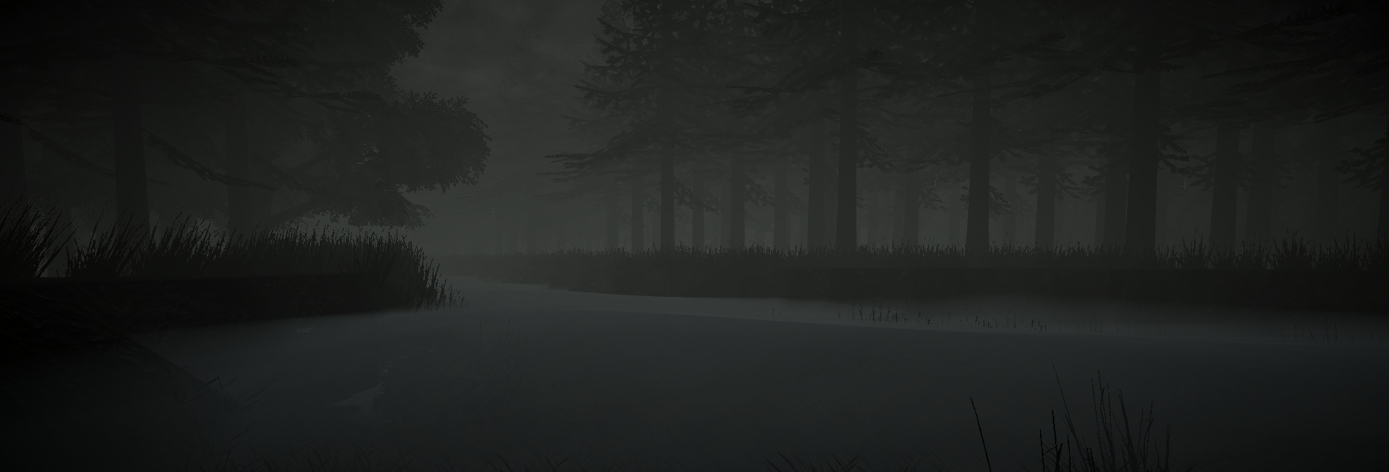
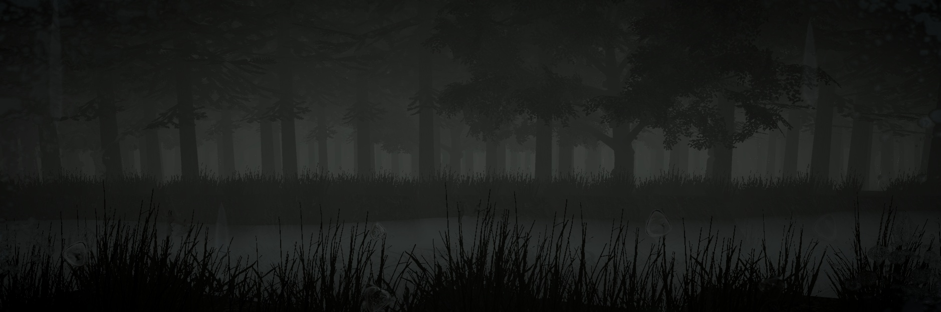
General View of the Forest

Slide 11
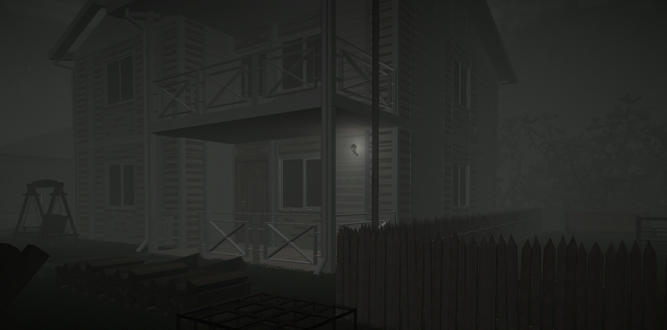
View of the Main Character's House

Slide 12
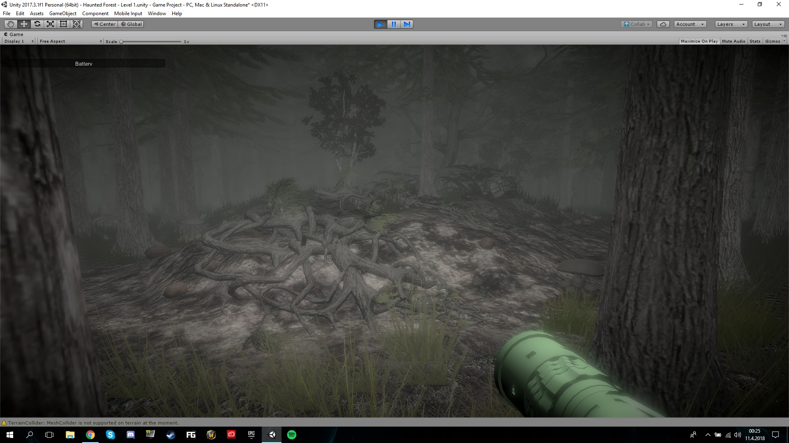
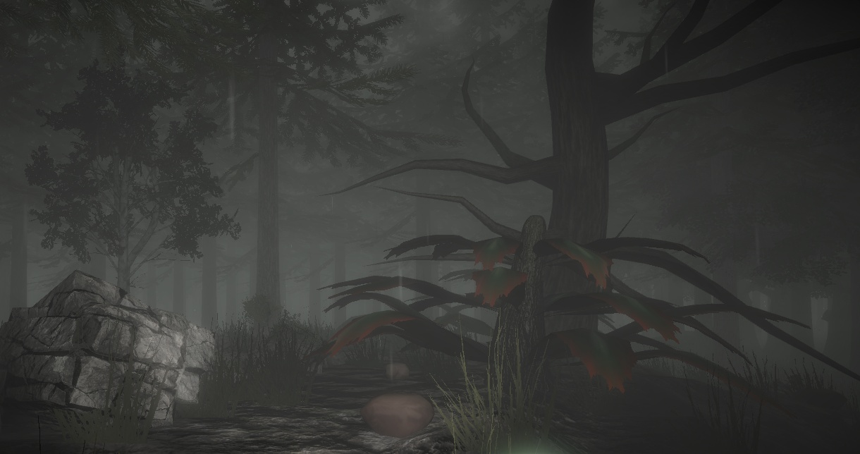
Different assets such as roots, trees/plants, stones/boulders and mushrooms are placed on the scene. We've created a foggy environment to reflect a scary forest.

Slide 13
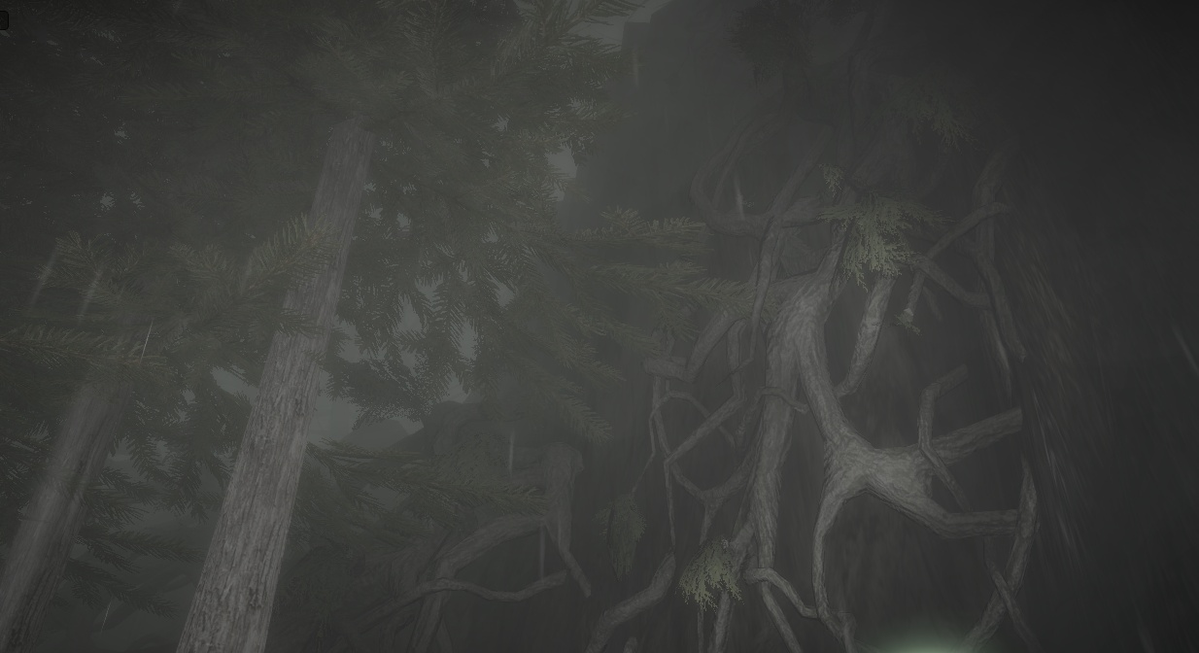
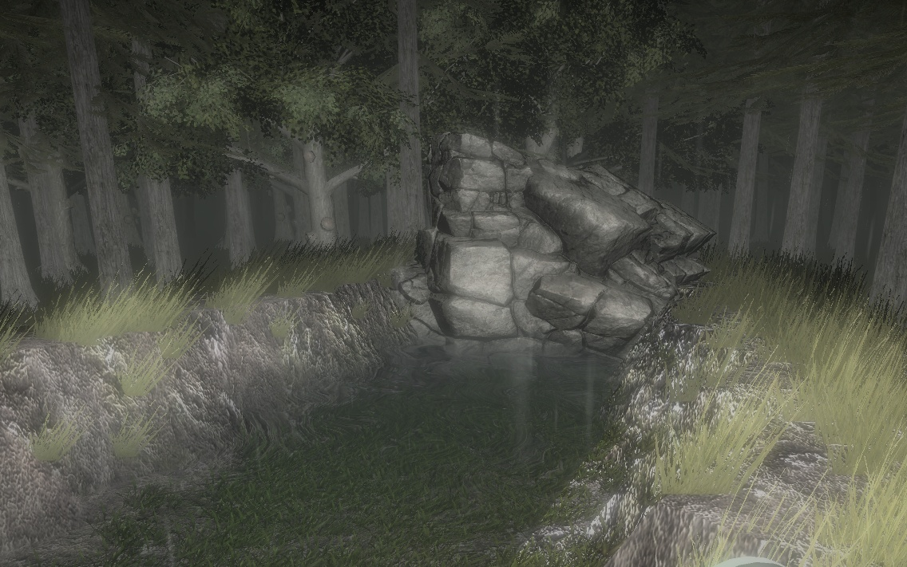

Slide 14
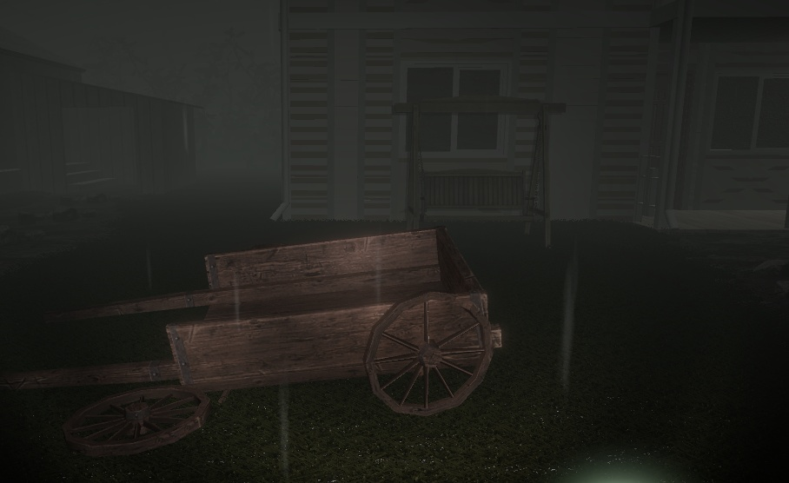
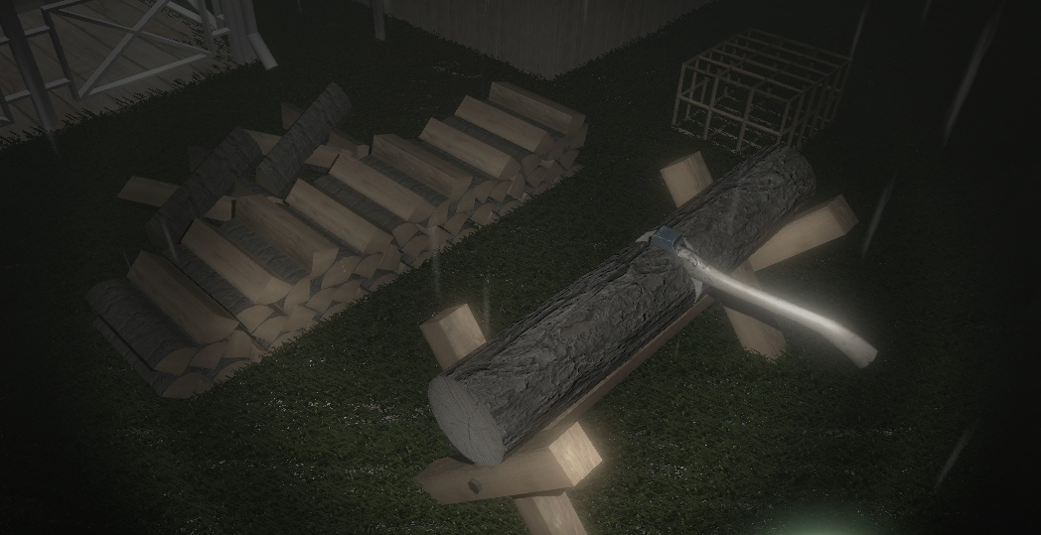
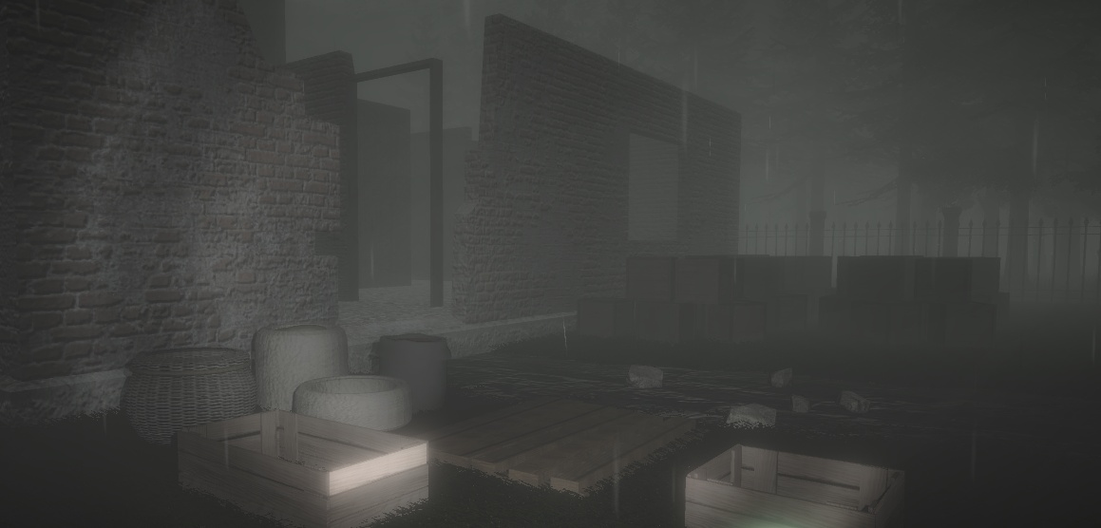
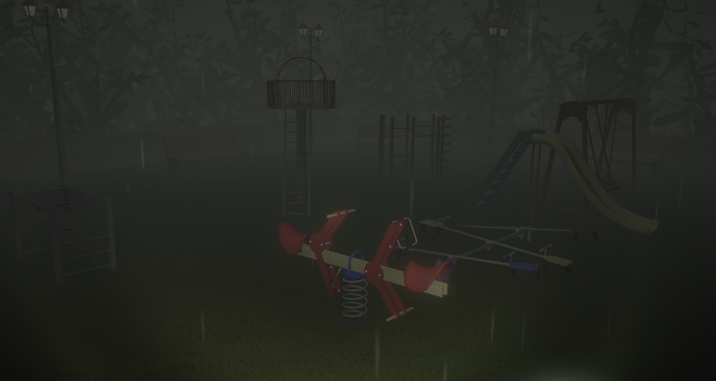

Slide 15
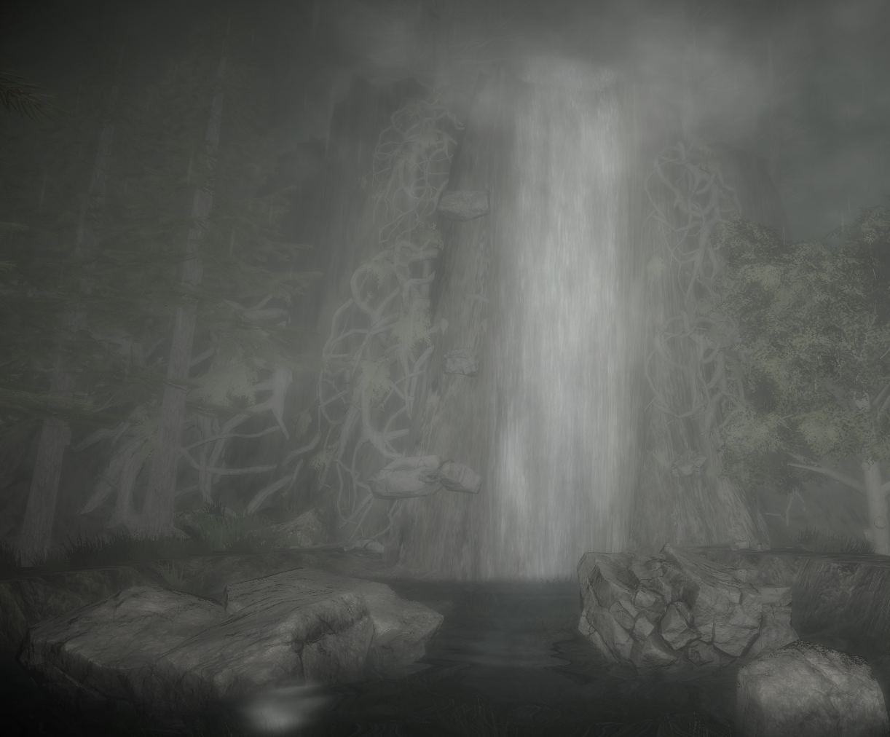
LEVEL 1 – HAUNTED FOREST (#P2) SOME DETAILS

Slide 16
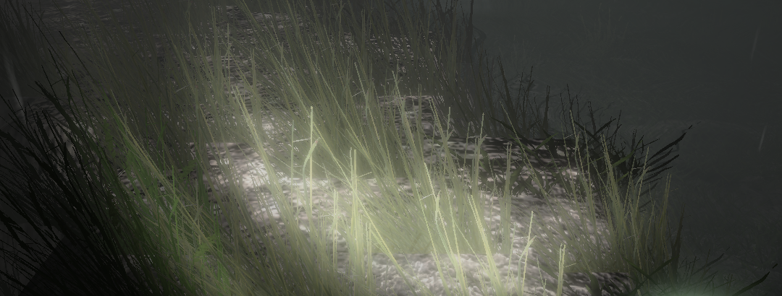
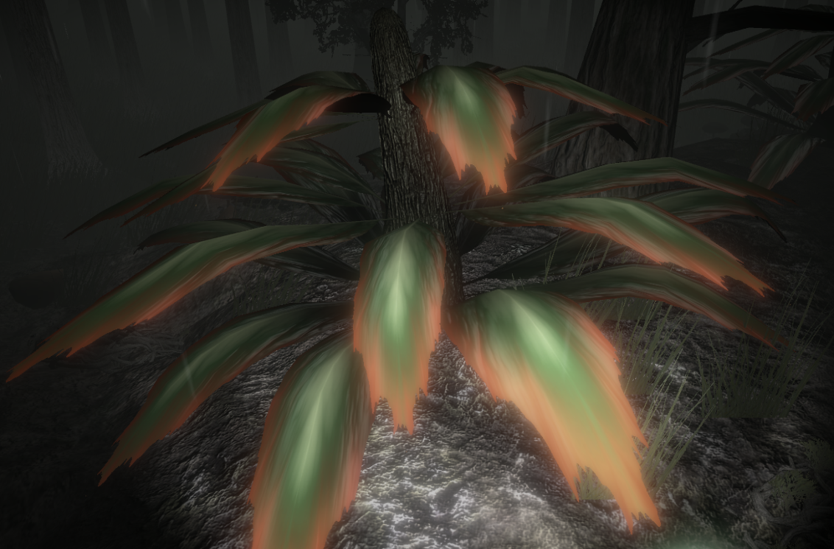
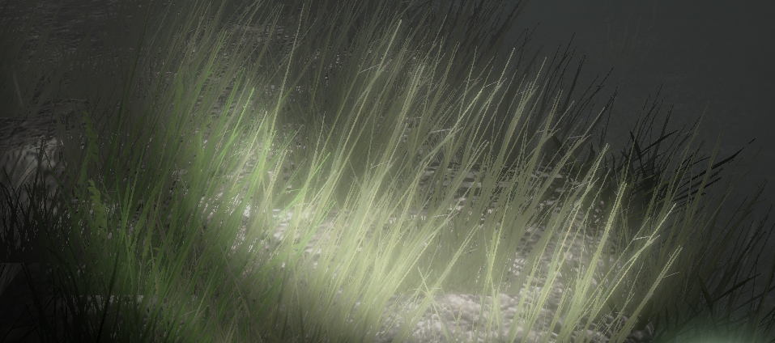
WINDZONE
Wind effect on tree leaves/grass is created using Unity’s windzone, this made it easier for the user to feel that the atmosphere is bad and creepy.

Slide 17
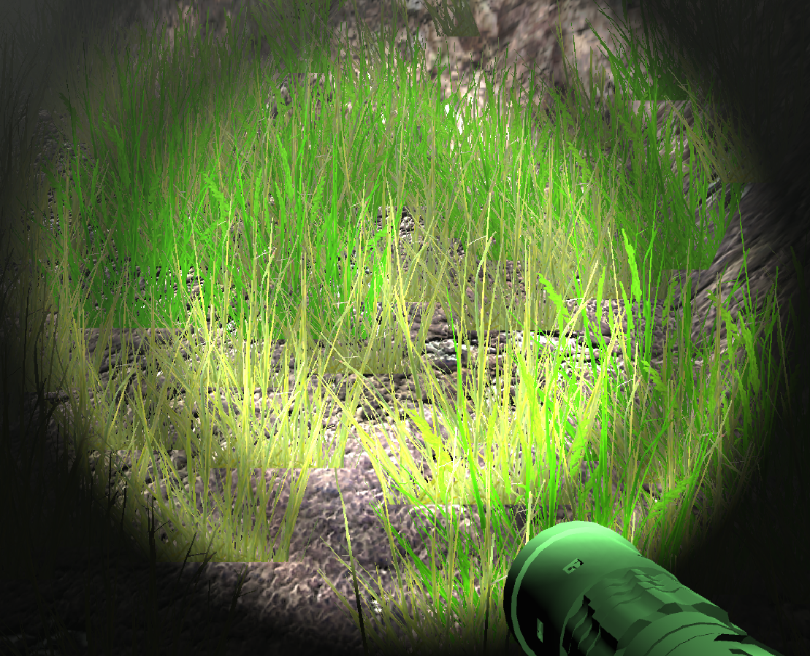
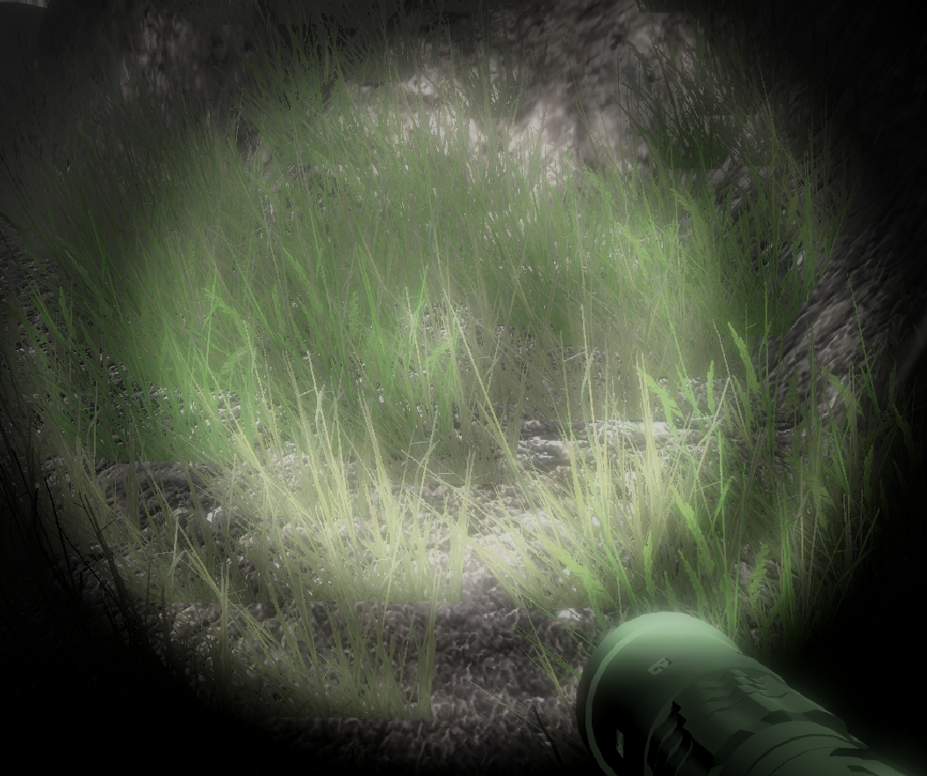
POST PROCESSING
Post-processing (Unity Asset) is the process of applying full-screen filters and effects to a camera’s image buffer before it is displayed to screen.

Slide 18
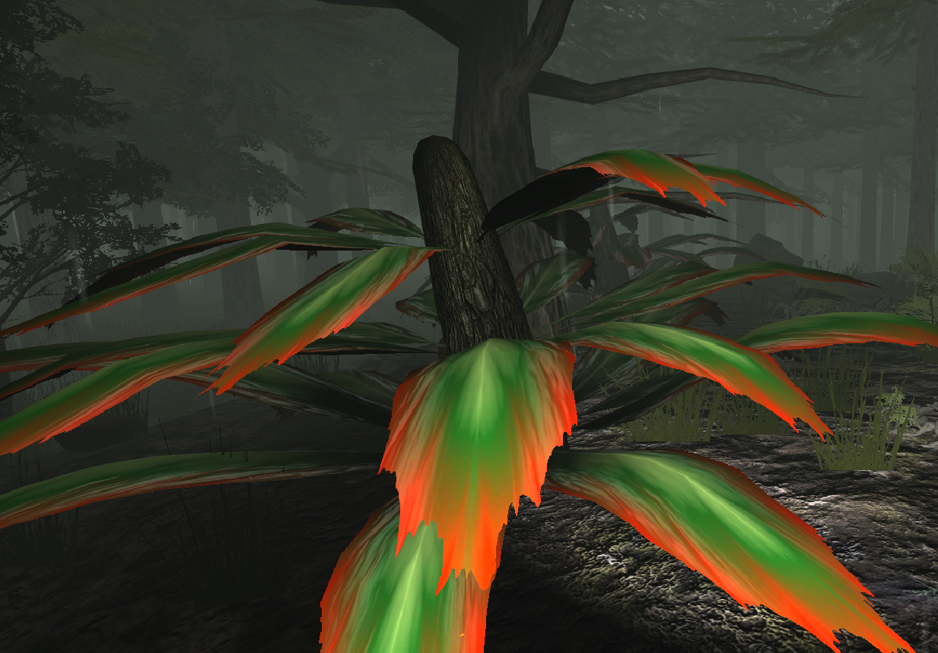
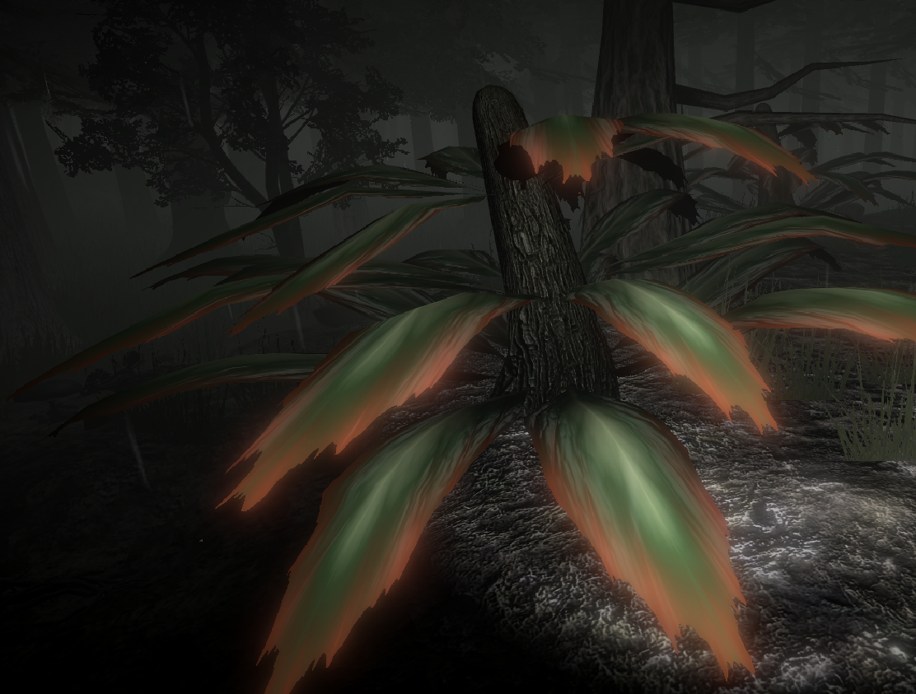
Fog, bloom, vignette, depth of field and color grading attributes are used to make scene look more frightening.

Slide 19
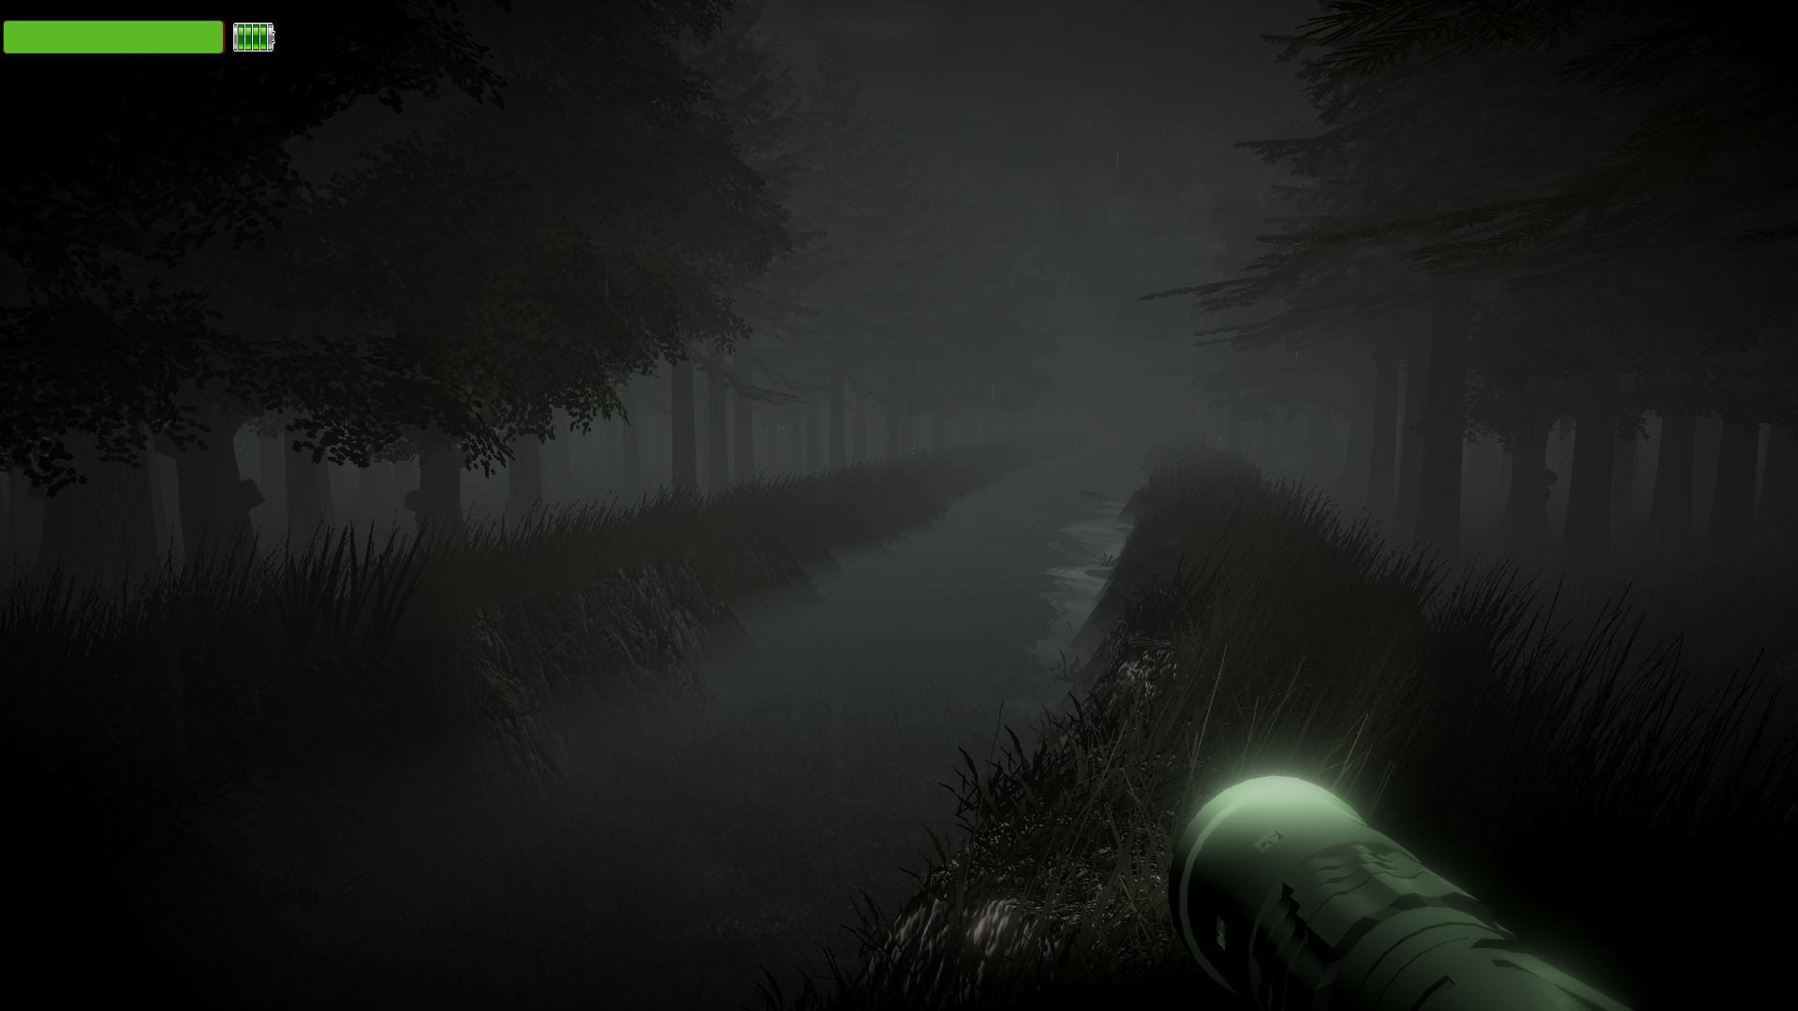
FLASHLIGHT & UI

Slide 20
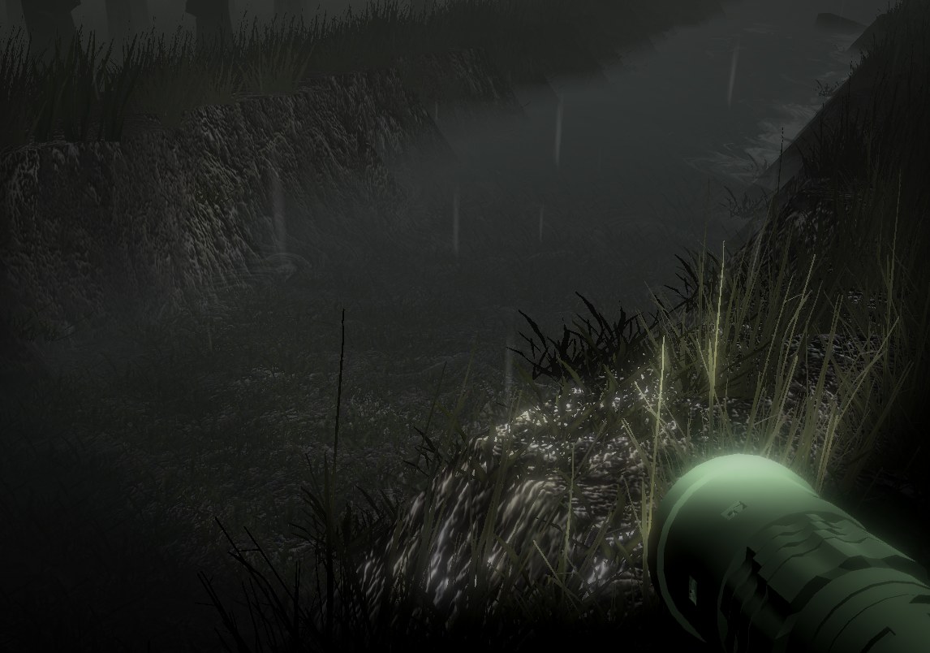
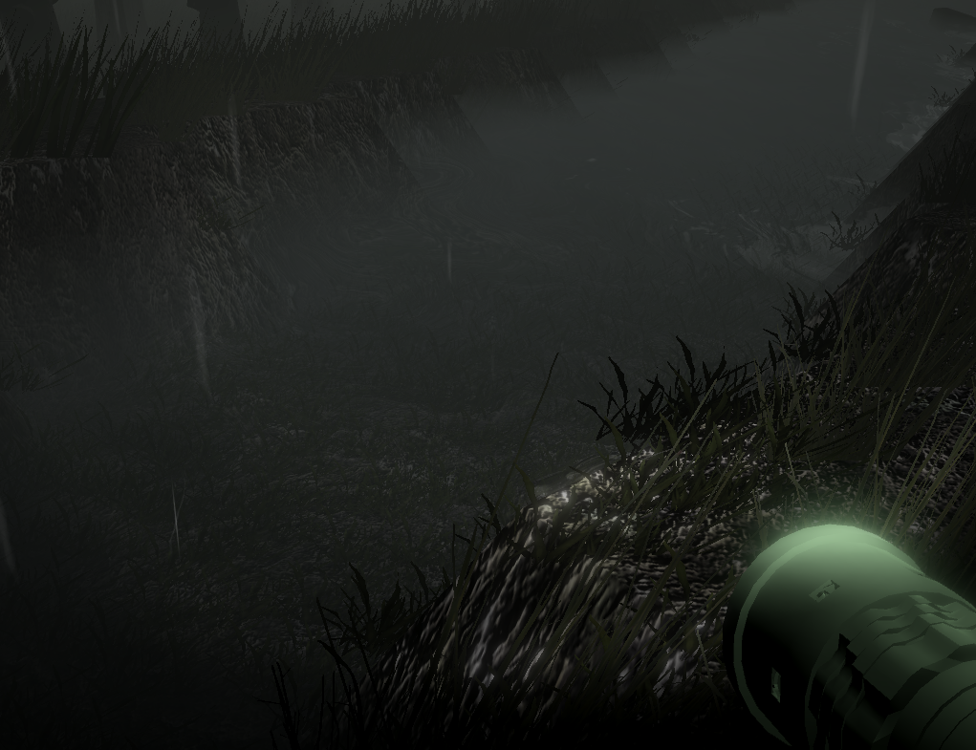
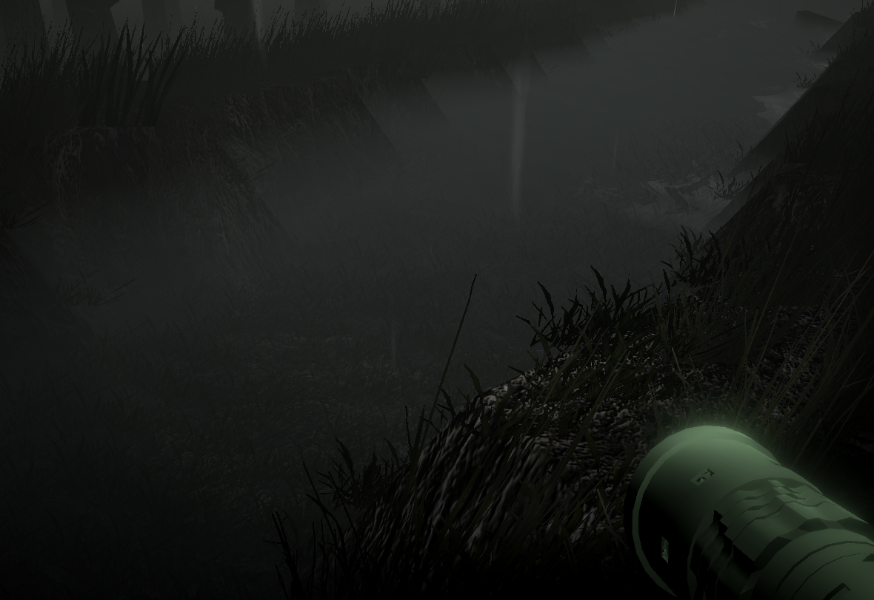



The battery is diminished as long as the flashlight is kept open, the intensity of the light will decrease and at the end it will close. Also player can follow the battery power on the upper left screen GUI.

Slide 21
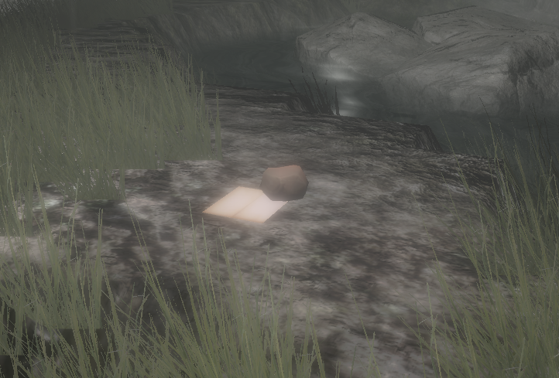
PUZZLE WALKTHROUGH
By leaving notes for the character, we aimed to design a puzzle that requires user to think about the content of the note. Also notes uses little pieces of the story.

Slide 22
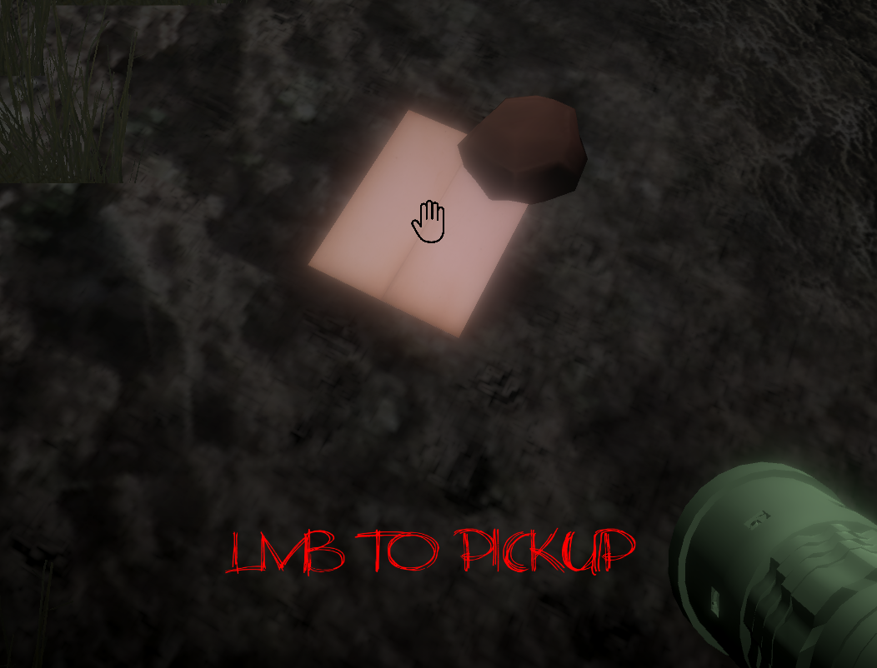
- When user gets close to the note and looks at the note, a hand icon and a message appears on the screen.
- There are 3 notes in the scene and each note appears in specific order. If user does not take the first note, the second one will not appear until user gets the first one.
- When user takes the note, FPSController will be deactivated, so user cannot walk before leaving the note.

Slide 23
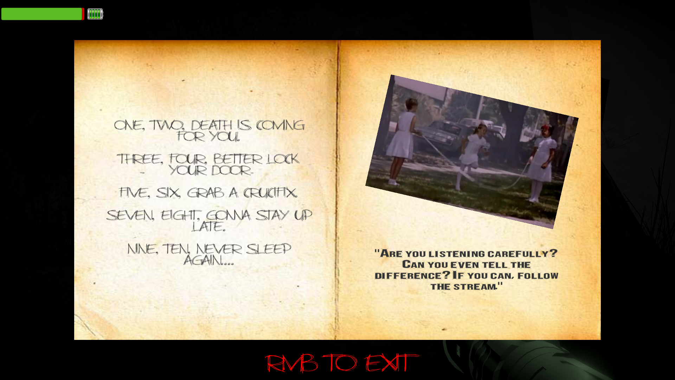
FIRST NOTE
Bold written text is a hint for the player.
- In the first note there will be nursery rhyme played on the background (Written on the left side).
Girl on the photo is his daughter actually. But we will get into that storytelling in the last demo.
One word differs from the song, we want user to notice that word. (“Death”)

Slide 24
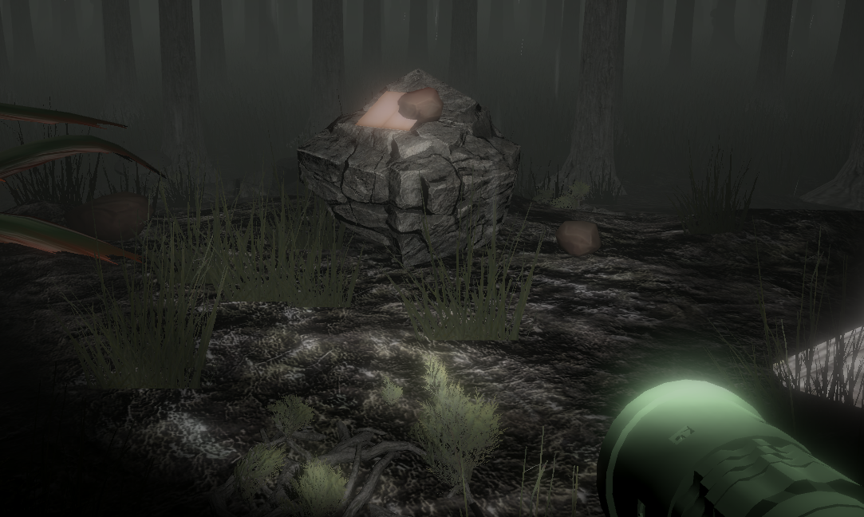
SECOND NOTE

Slide 25
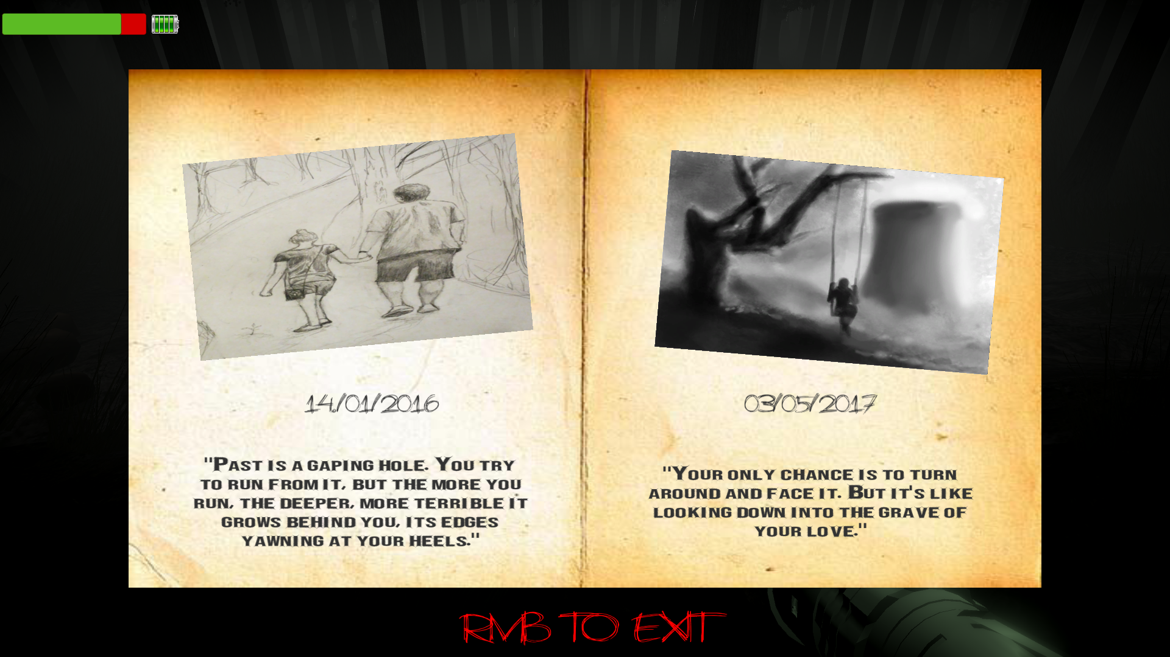
Bold written text is a hint for the player.
- In the second note there will be background sound of girl singing “La La La”.
Photos are the drawing of the father (main character) and daughter.
We want user to remember the date, when girls swings alone. (“03/05/17”)

Slide 26
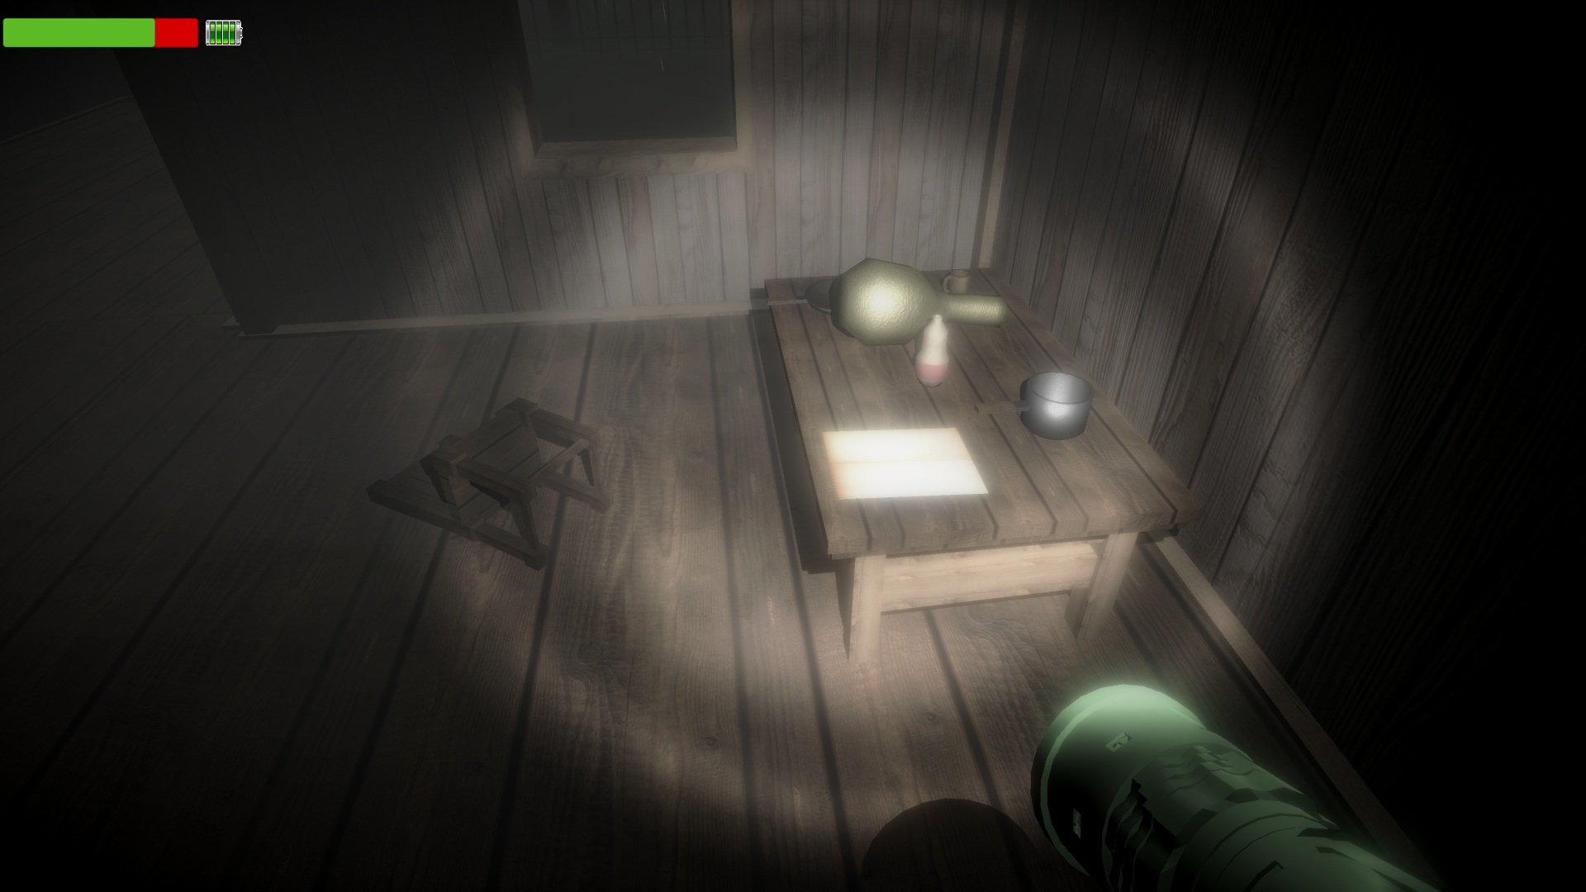
THIRD NOTE

Slide 27
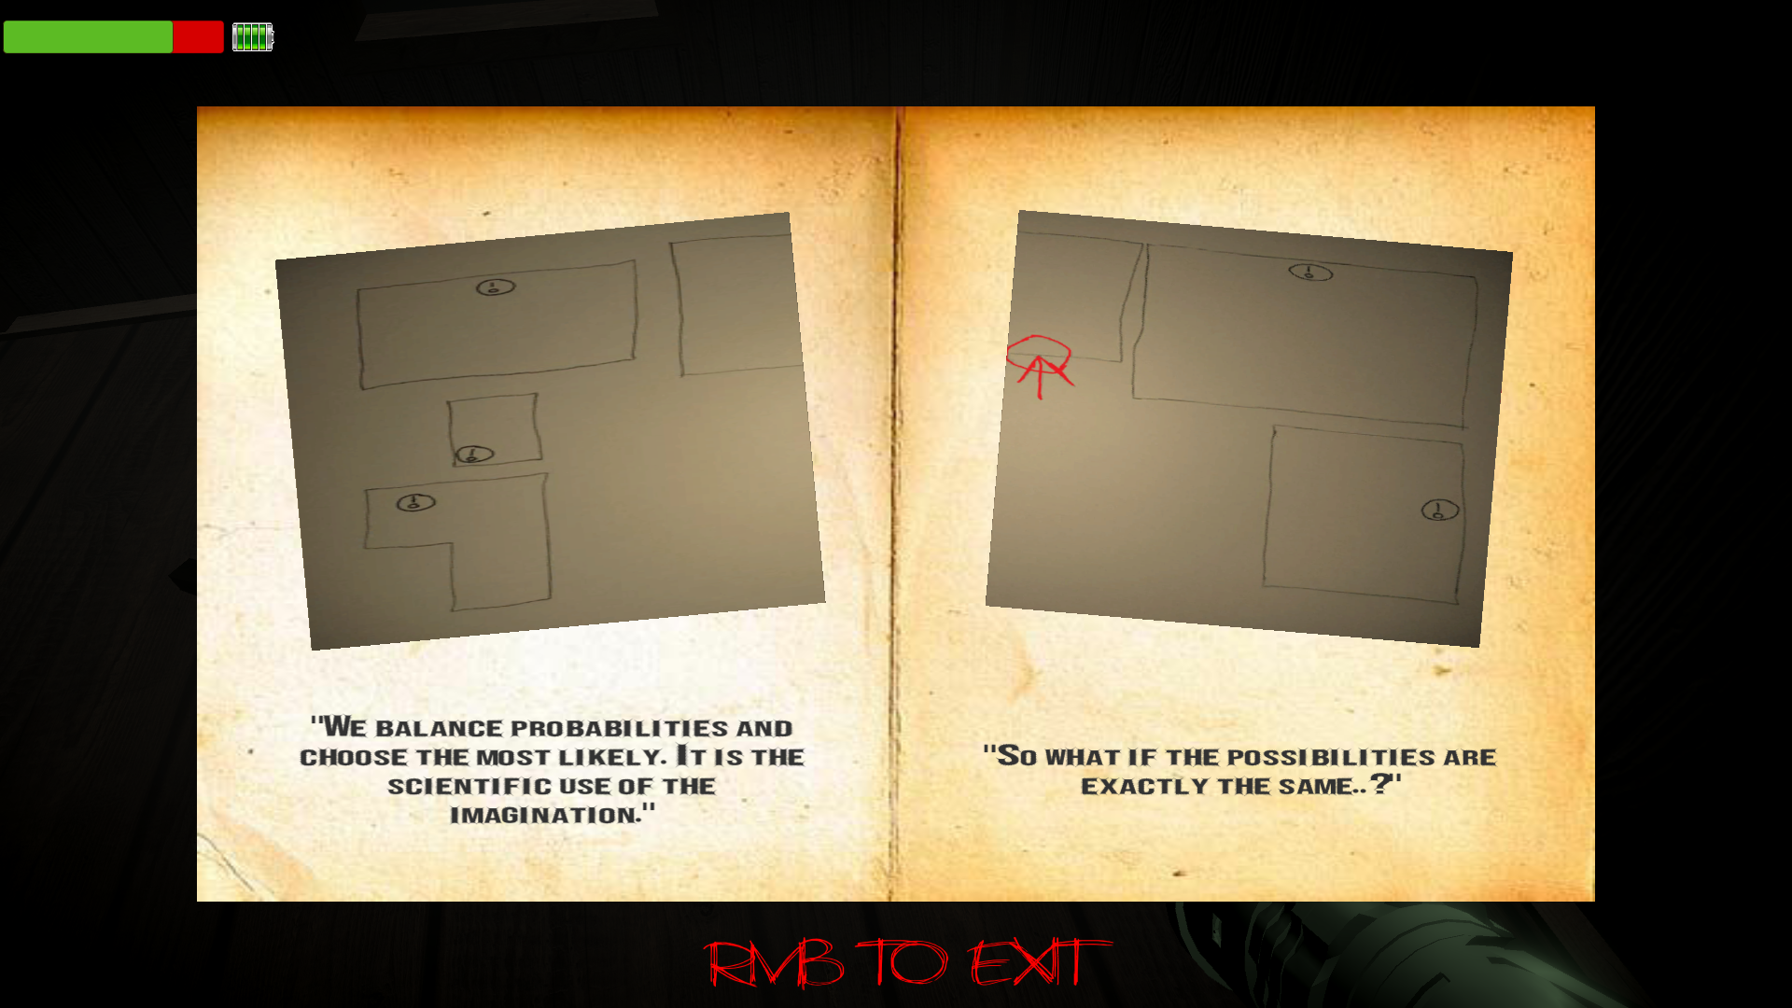
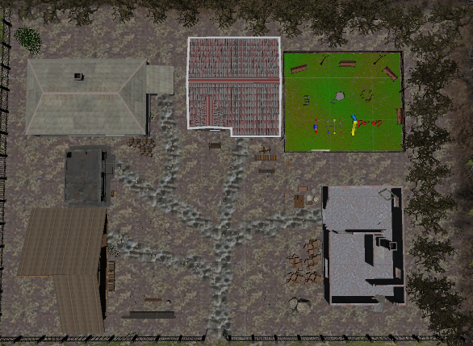
Bold written text is a hint for the player.
Photos are the drawing of the house and its surroundings.
We want user to find a key looking at this map, there are 5 different key locations. Key spawns at one of these locations randomly.

Slide 28
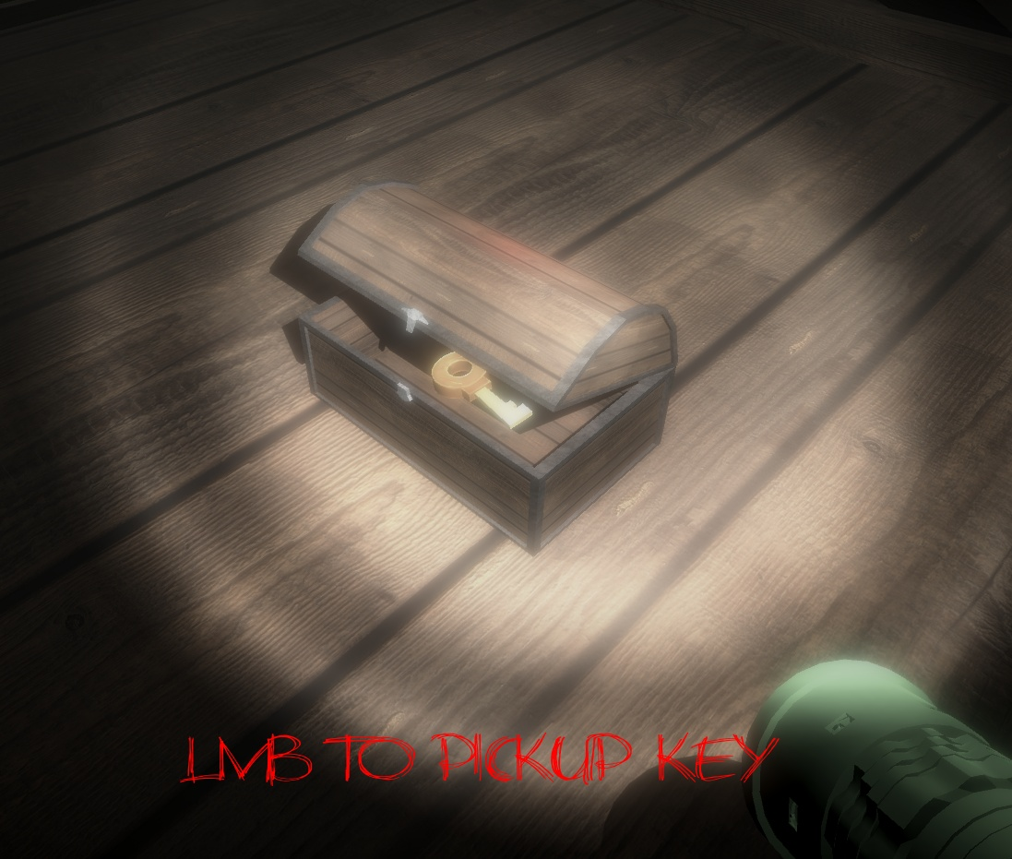
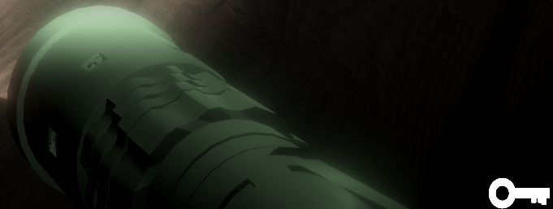
FINDING THE KEY

Slide 29
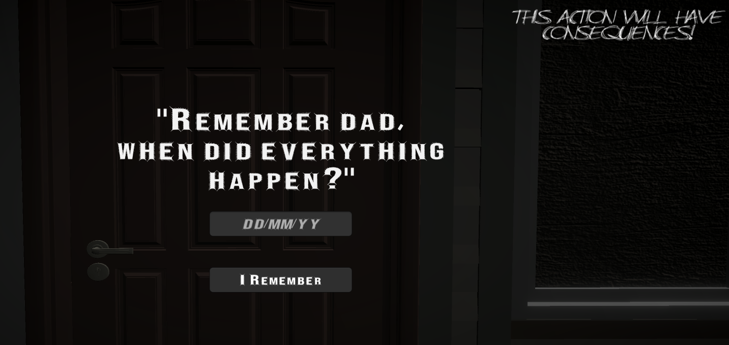
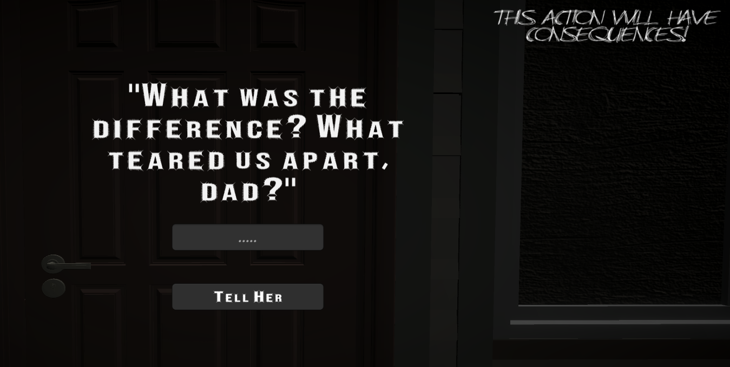
FINISHING THE PUZZLE
"03/05/17"
"Death"

Slide 30
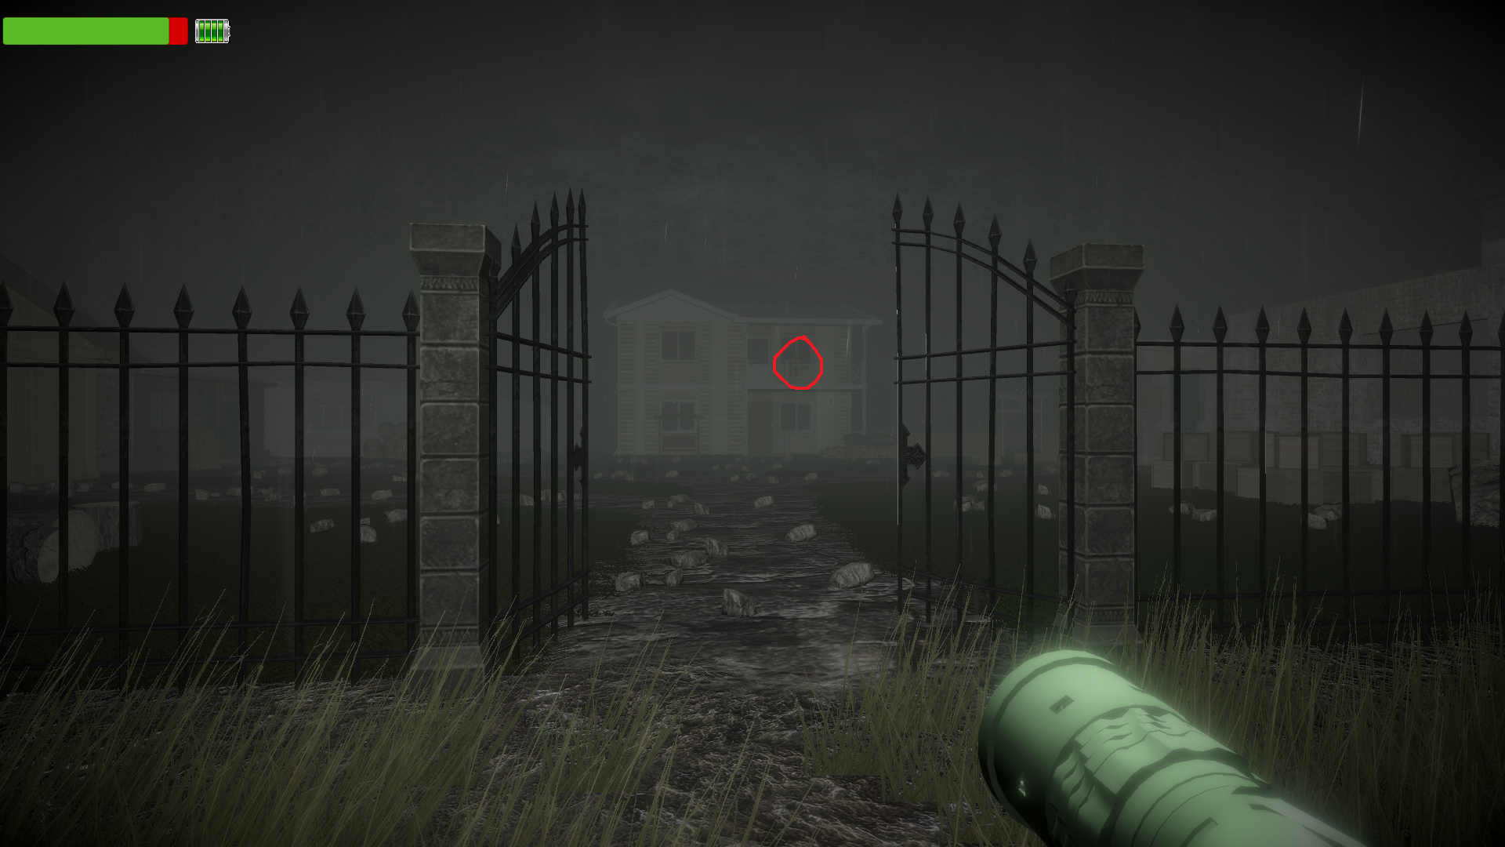
CREEPY MOMENTS

Slide 31
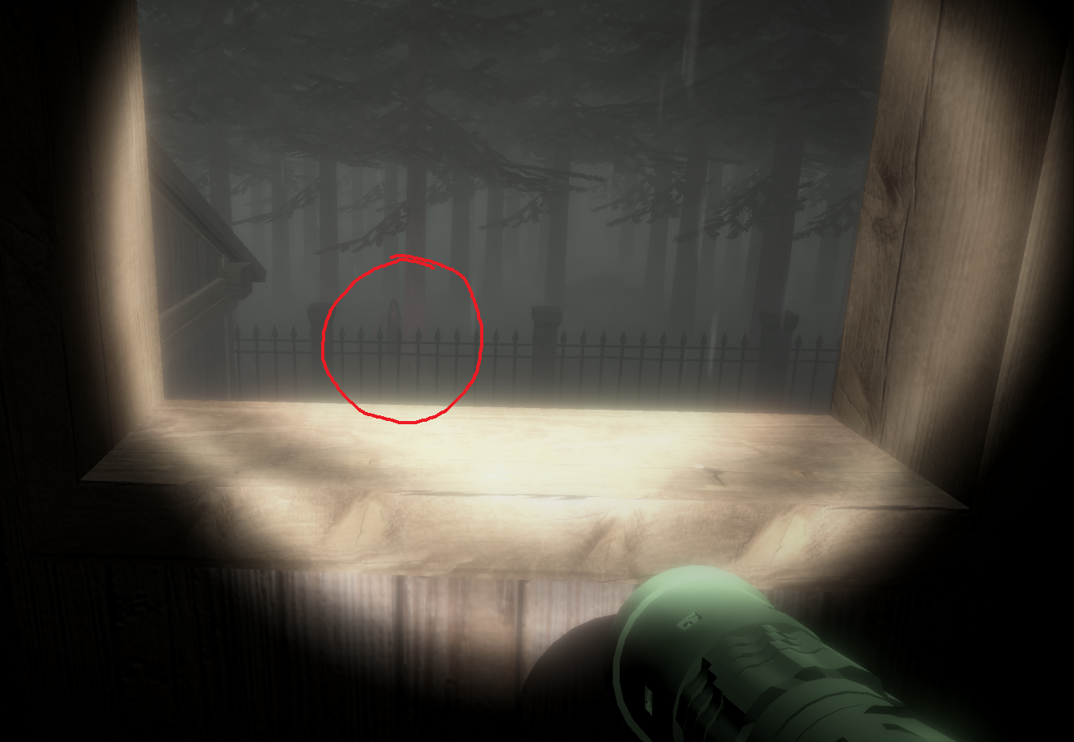
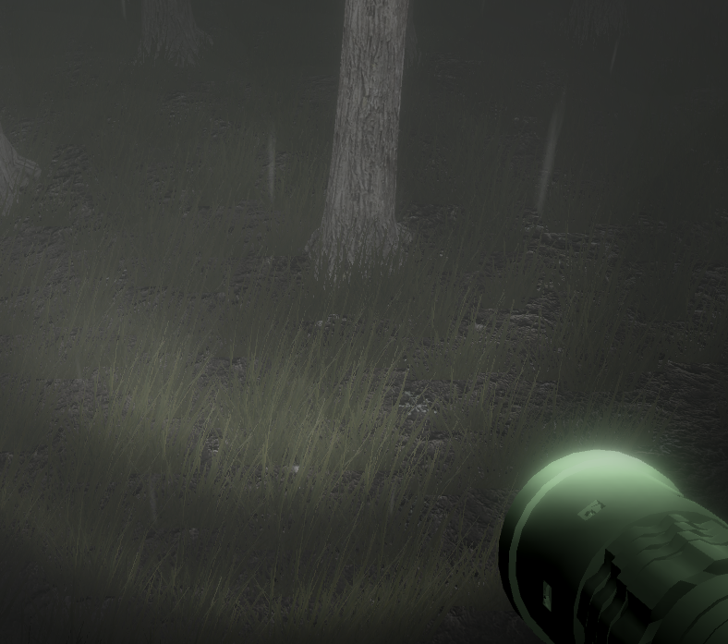

Slide 32
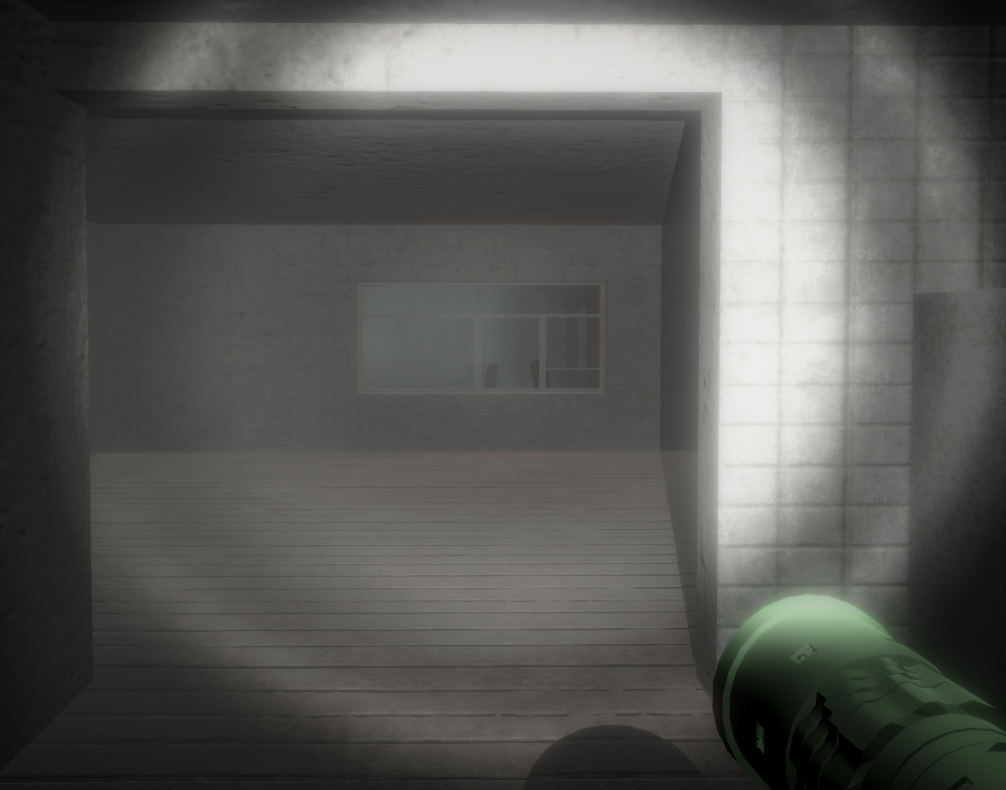
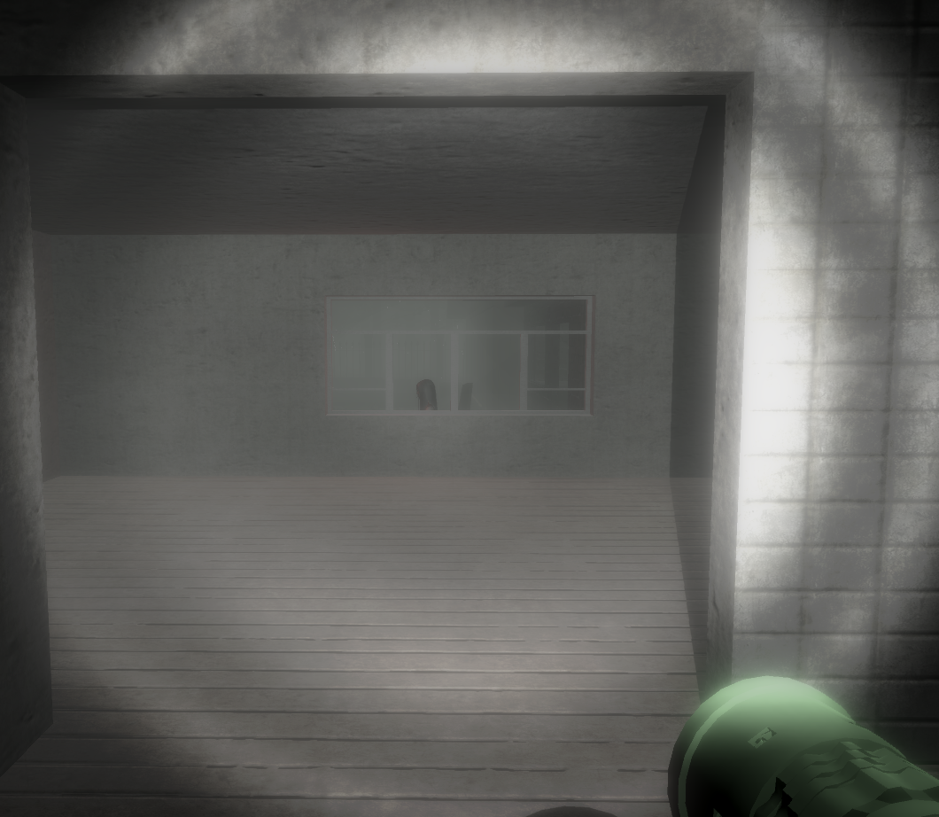

Slide 33
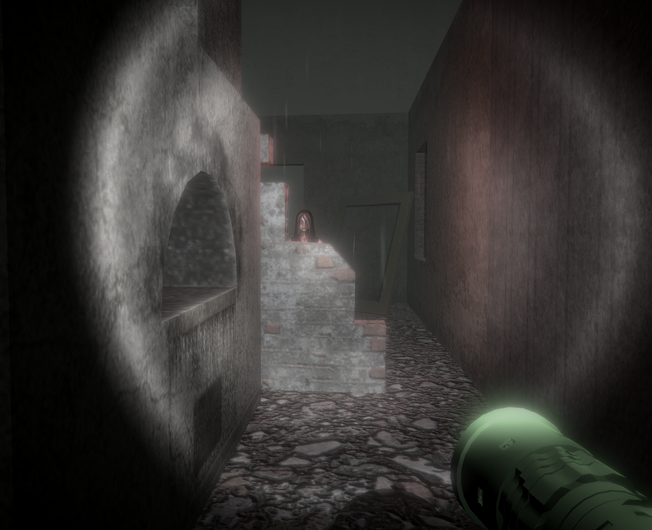

Slide 34
SOUND EFFECTS & MUSIC
There were many sounds used to boost the detail on the scene. For example, the sound of rain drops, the waterfall sound, the thunder, flickering light, the swing are used in the scene. On the second progress, for each pickup (key sound, paper sound), additional songs that a girl sings, scary sound effects when scary moments occur are used in the scene.

Slide 35

LEVEL 2 – BURNT HOUSE (SUMMARY OF #P1)
Proposal images of the level

Slide 36


General vıews of the level

Slide 37


GENERAL VIEWS OF THE LEVEL

Slide 38

General ArchItecture of the house
House have one bedroom, one kitchen/living room and one bathroom in ground floor. Other floor's of the house were burnt and unreachable in the game.

Slide 39

Bathroom
Bathroom includes a lot of assets. Bathtub, toilet, towels, washbasin, taps are some of them. Also bathroom has unique enviromental sound. When player enters to bathroom, the sound opens.

Slide 40


LIVING ROOM
Living room includes a lot of assets. Chairs, TV, coffee table, bookcase, vases, TV unit are some of the assets. There are some spotlights in the living room. These lights are inactive form they will be organized later of the project.

Slide 41

KıTcHEN
Kitchen includes a lot of assets. Sink, cabinets, tap, plates, chairs, pot, fridge, puff armchair, dump are some of the assets. In the architecture, stairs placed near the kitchen.

Slide 42

Bedroom
Bedroom includes a lot of assets. Lamp, bed, cabinets, mirror, study desk, chair are some them. A spotlight and collider system including in the bedroom. When player walked in the room flickering lamp will be active with sound effect.

Slide 43


Partıcle Systems
In the house many particle systems are used. They are white and black smoke particle systems, ember particle system, blood splash particle system, flame particle system and dust particle system. These systems can be increase in the future while developing.

Slide 44


Partıcle systems

Slide 45

PARTICLE SYSTEms

Slide 46
LEVEL 2 – BURNT HOUSE (#P2)

Slide 48
Sound Effects/MUsıc
House has three background music. They are girl playing song, fire sound and wind blowing sound. Electirical sizzle sound is in level but inactive form. It will be adding with spotlights.

Slide 49


LEVEL 3 – HOSPITAL (SUMMARY OF #P1)

Slide 50

General ARCHITECTURE OF HOSPITAL
Hospital have lot of rooms as patient rooms, bathrooms and doctors room. Each room have different structure.

Slide 51


General views of the level

Slide 52


Dıfferent Featured rooms

Slide 53

bathroom
The different forms of the rooms will make the game more interesting and player does not lose his/her enthusiasm.And the puzzle solving will become more complex.

Slide 54


Doctor's room
This room will be the room where the game ends. According to the progress of the player , scene might be change.

Slide 55
LEVEL 3 – HOSPITAL (#P2)

Slide 57

PROJECT PLAN – GANTT CHART

